Slide 1
Lesson 7: Arithmetic expressions
KS4 - Programming
Notes:
Last updated: 05-11-20
Resources are updated regularly - the latest version is available at: the-cc.io/curriculum.
This resource is licensed by the Raspberry Pi Foundation under a Creative Commons Attribution-NonCommercial-ShareAlike 4.0 International license. To view a copy of this license, visit, see creativecommons.org/licenses/by-nc-sa/4.0/.

Slide 2
Arithmetic expressions
Starter activity
number = 10-2+2*5
Question .
What value will be held by the variable number?
-2
18
50
30
Explorer task
Explain your answer
1
▹
2
3
4

Slide 3
BIDMAS
Starter activity
Arithmetic expressions are evaluated in order of operator precedence.
You can use BIDMAS to help remind you of the correct order.
It is important to note that add and subtract are interchangeable and should be evaluated from left to right.
B - brackets
I - indices
D - division
M - multiplication
A - addition
S - subtract

Slide 4
BIDMAS
Starter activity
In your maths lessons you might have seen BIDMAS represented in a triangle like this diagram.
()
4²
/ *
+ -

Slide 5
BIDMAS
Starter activity
10-2+2*5
BIDMAS
There are no brackets, indices, or division in this expression, so start with multiplication.
()
4²
/ *
+ -

Slide 6
BIDMAS
Starter activity
10-2+2*5
BIDMAS
There are no brackets, indices, or division in this expression, so start with multiplication.
2*5 is 10
()
4²
/ *
+ -

Slide 7
BIDMAS
Starter activity
10-2+2*5
10-2+10
BIDMAS
There are no brackets, indices, or division in this expression, so start with multiplication.
2*5 is 10
()
4²
/ *
+ -

Slide 8
BIDMAS
Starter activity
10-2+2*5
10-2+10
BIDMAS
There are no brackets, indices, or division in this expression, so start with multiplication.
2*5 is 10
()
4²
/ *
+ -

Slide 9
BIDMAS
Starter activity
10-2+2*5
10-2+10
BIDMAS
Add and subtract should be read from left to right. If the subtract appears first, then this should be carried out first.
10-2 is 8
()
4²
/ *
+ -

Slide 10
BIDMAS
Starter activity
10-2+2*5
10-2+10
8+10
BIDMAS
Add and subtract should be read from left to right. If the subtract appears first, then this should be carried out first.
10-2 is 8
()
4²
/ *
+ -

Slide 11
BIDMAS
Starter activity
10-2+2*5
10-2+10
8+10
BIDMAS
Finally, you are left with one operator and perform this final calculation.
8 + 10 is 18
()
4²
/ *
+ -

Slide 12
BIDMAS
Starter activity
10-2+2*5
10-2+10
8+10
18
BIDMAS
Finally, you are left with one operator and perform this final calculation.
8 + 10 is 18
()
4²
/ *
+ -

Slide 13
Lesson 7: Arithmetic expressions
Objectives
In this lesson, you will:
Evaluate arithmetic expressions using rules of operator precedence (BIDMAS)
Write and use expressions that use arithmetic operators (add, subtract, multiply, real division, integer division, MOD, to the power)
Assign expressions to variables

Slide 14
Using operators in Python
Activity 1
Here is a list of arithmetic operators that can be used in Python.
+ Addition
- Subtraction
* Multiplication
/ Real division
// Integer division (quotient)
** Powers
% Modulo (MOD)

Slide 15
Using operators in Python
Activity 1
Integer division and modulo are possibly unfamiliar to you.
+ Addition
- Subtract
* Multiplication
/ Real division
// Integer division (quotient)
** Powers
% Modulo (MOD)

Slide 16
Using operators in Python
Activity 1
Here is an example of how real division will output.
In real division there is no remainder because the entire value is divided.
1
2
3
number = 14/3
print(number)
4.666666666666667
>>>
Notes:
If you are typing this directly into the shell, then the print is no longer needed and it will be quicker to show more examples.

Slide 17
Using operators in Python
Activity 1
When you use integer division, it will discard the decimal part.
Integer division is the operation that calculates how many whole times the divisor (3) will fit in the dividend (14).
1
2
3
number = 14//3
print(number)
4
>>>

Slide 18
Using operators in Python
Activity 1
Modulo (MOD) is used to work out the remainder of the division.
1
2
3
number = 14%3
print(number)
2
>>>

Slide 19
Using operators in Python
Activity 1
If you divide 14 counters between 3 people, then there will be 4 counters each with 2 remaining.
Note: The MOD doesn’t simply store the value that was discarded from integer division. It stores the whole number that was remaining.
1
2
3
4
counters_each = 14//3
counters_remaining = 14%3
print(counters_each)
print(counters_remaining)
4
2
>>>
Notes:
Person icon source: https://pixabay.com/vectors/person-individually-alone-icon-1824147/

Slide 20
Using operators in Python
Activity 1
You would use modulo when you need to find out the remaining whole value.
This will be helpful in many cases. An example might be when you wish to find out if a value is odd or even.
If the value evaluates as a 1, then it is odd.
1
2
3
number = 27
odd_even = number%2
print(odd_even)
1
>>>

Slide 21
Using operators in Python
Activity 1
If the value evaluates as a 0, then it is even.
1
2
3
number = 26
odd_even = number%2
print(odd_even)
0
>>>

Slide 22
Integer division and modulo
Activity 2
number = 25%4
Question .
What value will be held by the variable number?
6.25
1
6
% is not a valid operator so this will cause an error message.
1
▹
2
3
4

Slide 23
Integer division and modulo
Activity 2
number = 10/3
Question .
What value will be held by the variable number?
3.3333333333333335
3
1
/ is not a valid operator so this will cause an error message.
▹
1
2
3
4

Slide 24
Integer division and modulo
Activity 2
number = 13//3
Question .
What value will be held by the variable number?
1
4.333333333333333
4
// is not a valid operator so this will cause an error message.
1
2
▹
3
4

Slide 25
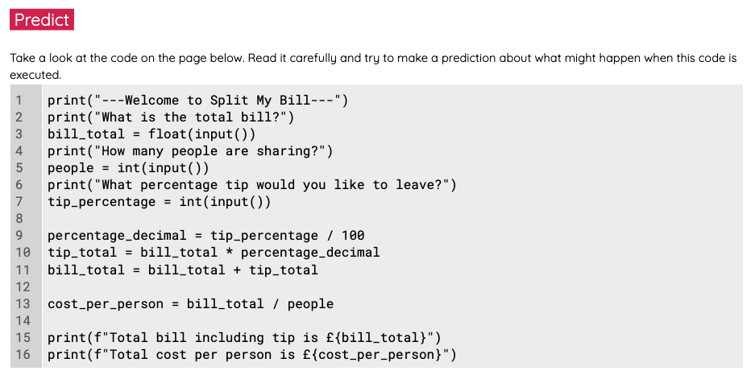
The ‘Split my bill’ app
Activity 2
Use the ‘Split my bill’ worksheet to investigate a program that has been designed to help friends split the bill at a restaurant.

Slide 26
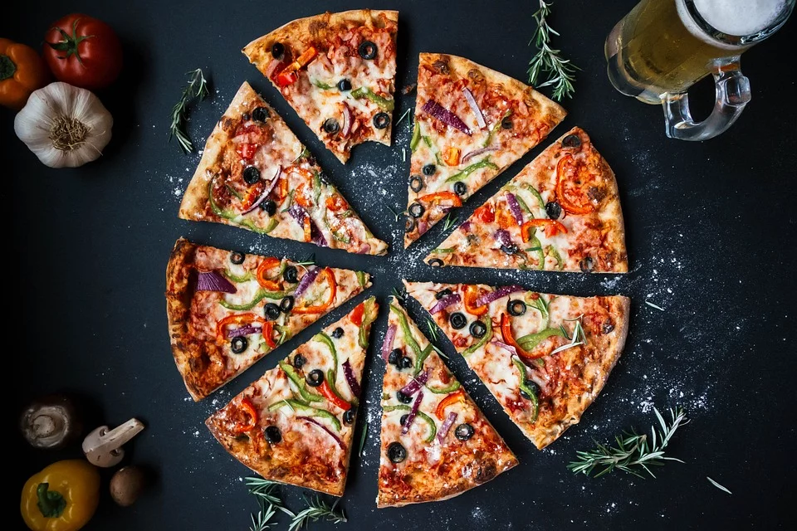
Learning partner feedback
Plenary
Discuss your solution to the make task with your learning partner.
Did you meet the requirements?
Did you try the explorer task?
What errors did you encounter and how did you overcome them?
How could you improve your program?
Notes:
Image source: https://pixabay.com/photos/pizza-food-italian-baked-cheese-3007395/

Slide 27
Homework: Finish the app
Homework
Complete the ‘Split my Pizza’ app.
Make improvements based on your peer feedback.
Due: Next lesson

Slide 28
Next lesson
Summary
In this lesson, you…
Learnt about BIDMAS and how this can help you with order of precedence
Explored arithmetic expressions
Familiarised yourself with integer division and modulo
Next lesson, you will…
Learn about selection statements and how these can be used to control the flow of execution in programs

