Slide 1
Lesson 8: Selection
Programming - KS4
Notes:
Last updated: 05-11-20
Resources are updated regularly - the latest version is available at: the-cc.io/curriculum.
This resource is licensed by the Raspberry Pi Foundation under a Creative Commons Attribution-NonCommercial-ShareAlike 4.0 International license. To view a copy of this license, visit, see creativecommons.org/licenses/by-nc-sa/4.0/.

Slide 2
Make a prediction
Starter activity
Question .
If you input the number 10, what will be the output?
Start
Input number
number > 5
False
Output number - 5
True
Output number + 5
End

Slide 3
Make a prediction
Starter activity
10 is more than 5
So this will be True
Start
Input number
number > 5
False
Output number - 5
True
Output number + 5
End

Slide 4
Make a prediction
Starter activity
10 + 5 is 15
So the output will be 15
Start
Input number
number > 5
False
Output number - 5
True
Output number + 5
End

Slide 5
Make a prediction
Starter activity
The decision symbol is used in a flowchart to control the flow of execution.
Inside the diamond is a condition. If the condition is True, then during program execution it will follow one path. If it is False, it will follow the other path.
number > 5
False
True

Slide 6
Lesson 8: Selection
Objectives
In this lesson, you will:
Identify flowchart symbols and describe how to use them (decision)
Define a condition as an expression that can be evaluated to either True or False
Identify that selection uses conditions to control the flow of execution
Walk through code that includes selection (if, elif, else)

Slide 7
What is a condition?
Activity 1
You already know that arithmetic expressions evaluate to a number.
1
2
3
number = 30 + 3
print(number)
33
>>>

Slide 8
What is a condition?
Activity 1
Logical expressions evaluate to True or False.
1
2
3
score = 20
you_won = score > 30
print(you_won)
False
>>>

Slide 9
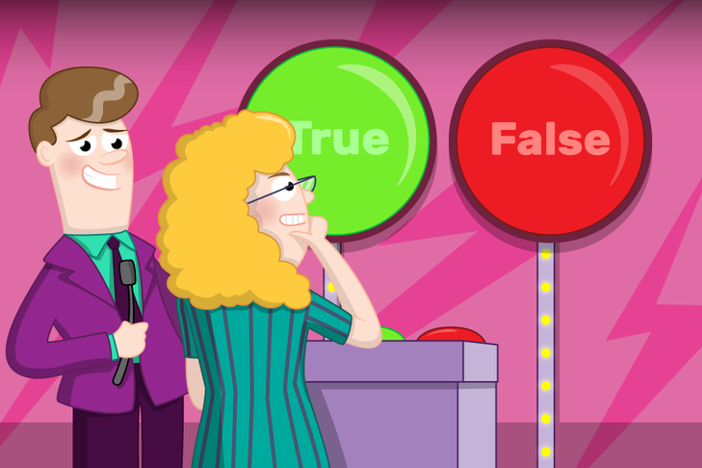
Will the following logical expressions evaluate to True or False?
Activity 1
Notes:
Image from Raspberry Pi Foundation FutureLearn course

Slide 10
3 > 4
Activity 1
Comparison operators == equal to
< less than
> more than

Slide 11
False
Activity 1

Slide 12
(3+10) < (3*10)
Activity 1
Comparison operators == equal to
< less than
> more than

Slide 13
True
Activity 1

Slide 14
(5-2+10/2) == 8
Activity 1
Comparison operators == equal to
< less than
> more than

Slide 15
True
Activity 1

Slide 16
Selection
Activity 1
You can use a logical expression in a condition to control the flow of execution in your programs.
1
2
3
score = 20
if score > 30:
print("You won!")

Slide 17
Selection
Activity 1
You can use a logical expression in a condition to control the flow of execution in your programs.
Here a condition has been used in a selection statement.
This is also known as an if statement.
1
2
3
score = 20
if score > 30:
print("You won!")

Slide 18
Selection
Activity 1
Selection statements control the flow of execution because a block of code will only run if the condition is True.
1
2
3
score = 20
if score > 30:
print("You won!")

Slide 19
Selection: walkthrough
Activity 1
1
2
3
4
score = 20
if score > 30:
print("You won!")
print("The end")
Here is a walkthrough of a selection statement.

Slide 20
Selection: walkthrough
Activity 1
1
2
3
4
score = 20
if score > 30:
print("You won!")
print("The end")
score is assigned 20

Slide 21
Selection: walkthrough
Activity 1
1
2
3
4
score = 20
if score > 30:
print("You won!")
print("The end")
State .
score
20
score is assigned 20

Slide 22
Selection: walkthrough
Activity 1
1
2
3
4
score = 20
if score > 30:
print("You won!")
print("The end")
State .
False
score
20
score is not greater than 30, so the condition is False

Slide 23
Selection: walkthrough
Activity 1
1
2
3
4
score = 20
if score > 30:
print("You won!")
print("The end")
State .
score
20
Output .
The end
The flow of control moves to line 4 and outputs The end

Slide 24
Selection: walkthrough
Activity 1
1
2
3
4
score = 35
if score > 30:
print("You won!")
print("The end")
This time, score is assigned 35

Slide 25
Selection: walkthrough
Activity 1
1
2
3
4
score = 35
if score > 30:
print("You won!")
print("The end")
This time, score is assigned 35

Slide 26
Selection: walkthrough
Activity 1
1
2
3
4
score = 35
if score > 30:
print("You won!")
print("The end")
State .
score
35
This time, score is assigned 35

Slide 27
Selection: walkthrough
Activity 1
1
2
3
4
score = 35
if score > 30:
print("You won!")
print("The end")
State .
True
score
35
score is over 30 so this condition is now True

Slide 28
Selection: walkthrough
Activity 1
1
2
3
4
score = 20
if score > 30:
print("You won!")
print("The end")
State .
score
35
Output .
You won!
The flow of execution moves to line 3 and outputs You won!

Slide 29
Selection: walkthrough
Activity 1
1
2
3
4
score = 20
if score > 30:
print("You won!")
print("The end")
State .
score
35
Output .
You won!
The end
The flow of execution then carries on to line 4 and outputs The end

Slide 30
Another branch
Activity 1
You can provide another branch to your selection statement by using if-else.
When you use if-else you are saying:
“If this condition is True then do this. Else, do this.”
if this_is_true:
do this
else:
do this

Slide 31
Activity 1
An example of using else
print("What’s your name?")
user = input()
if user == "Elizabeth":
print("Good morning Your Majesty")
else:
print("Hello", user)
The condition will check if the value of user is equal to the string "Elizabeth".
The expression user == "Elizabeth" will evaluate to either True or False.
This is the if-block, i.e. the code that will be executed if the condition is True.
This is the else-block, i.e. the code that will be executed if the condition is False.
Only one of these blocks will be executed, depending on the value of the condition.

Slide 32
More branches!
Activity 1
You can provide further branches by using elif.
When you use if-elif-else you are saying:
“If this condition is True then do this. Else if this condition is True then do this. Else, do this.”
if this_is_true:
do this
elif this_is_true:
do this
else:
do this

Slide 33
Activity 1
An example of using elif
print("What’s your name?")
user = input()
if user == "Elizabeth":
print("Good morning Your Majesty")
elif user == "Alan Sugar":
print("Good morning Sir")
else:
print("Hello", user)
If the expression user == "Elizabeth" is evaluated to False.
The elif condition will check if the value of user is equal to the string "Alan Sugar".
If this is True, the elif-block will be executed.
The else-block will be executed if both conditions are False.
Only one of these blocks will be executed, depending on the value of the conditions.

Slide 34
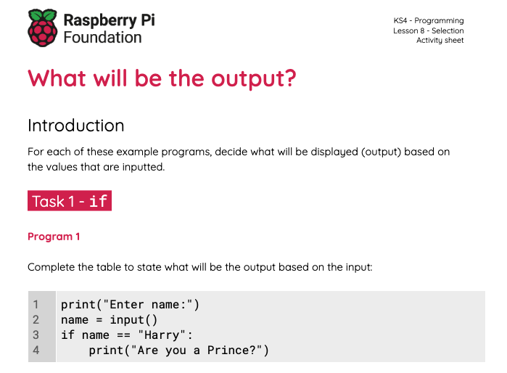
What will be the output?
Activity 1
Use the worksheet to decide what will be the output based on the input.

Slide 35
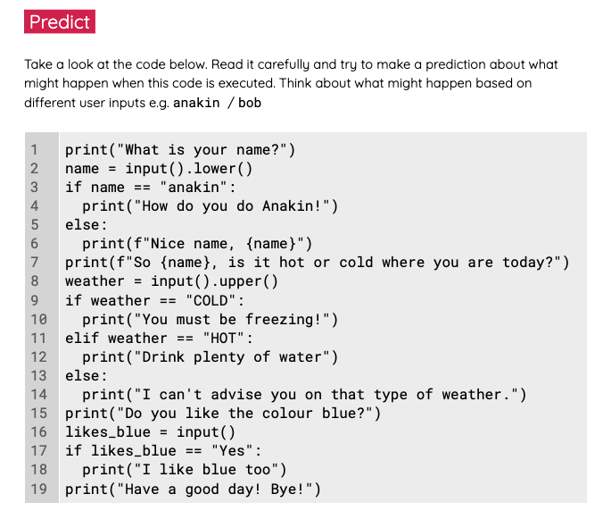
Chatterbot
Activity 2
Use the worksheet to investigate and modify a chatterbot.

Slide 36
Multiple choice questions
Plenary
Questions .
When this program is executed, what will be displayed on the screen, if the user enters Python at the prompt?
Wrong, Python is the best!
Hello Pythonista
Hello, Pythonista
Wrong, Python is the best!
There is an error in the program
print("Name the best programming language?")
language = input()
if language == "Python":
print("Hello Pythonista")
else:
print("Wrong, Python is the best!")
1
▹
2
3
4

Slide 37
Multiple choice questions
Plenary
Questions .
When this program is executed, what will be displayed on the screen if the user enters 0 at the prompt?
0 is positive 0 is negative
0 is negative
0 is positive
There is an error in the program
print("Enter a number")
number = int(input())
if number > 0:
print(f"{number}, is positive")
else:
print(f"{number}, is negative")
1
2
▹
3
4

Slide 38
Multiple choice questions
Plenary
Questions .
When this program is executed, what will be displayed on the screen?
small medium medium large
large
number = 13
if number < 10:
print("small")
elif number < 100:
print("medium")
elif number < 1000:
print("large")
1
▹
2
3
4

Slide 39
Next lesson
Summary
In this lesson, you…
Discovered how to use conditions to control the flow of execution in your programs
Next lesson, you will…
Make your own programs that use selection

